Slide 1

Rules 65G-13.001, .008
Florida Administrative Code
Room and Board
Agency for Persons with Disabilities
June 21, 2023
Public Rule Hearing

Slide 2
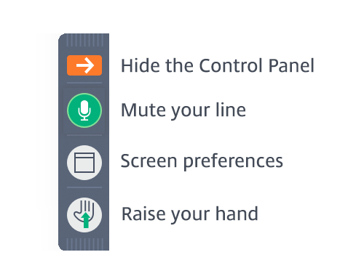
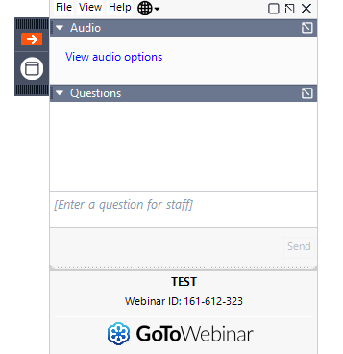
Webinar Participants
Attendee lines will be muted for the duration of the webinar. We will call on and unmute one attendee at a time to ensure every speaker is heard.
Please use the “Raise Your Hand” feature and we will unmute your line to ask questions/make comments verbally. We will use this feature to manage the workshop speakers.
You may also ask a questions/make comments at any time during the presentation by submitting into the “Questions” box of your webinar control panel.
This webinar is being recorded.

Slide 3
Rule 65G-13.001 and 13.008, F.A.C.
Purpose of the rule amendment and new rule are to establish a process for requesting and method for calculating a room and board reimbursement for a client that resides at an Agency for Persons with Disabilities licensed residential facility.

Slide 4
Rules of Chapter 65G-13, F.A.C.
Rule Number | Rule Title
65G-13.001 | Definitions
65G-13.008 | Room and Board

Slide 5
Thank You!
The Agency for Persons with Disabilities will accept written comments pertaining to these rules until close of business (5:00 p.m. EDT) on June 21, 2023. Please email these comments to Brett.Taylor@apdcares.org
The Agency will review and consider all comments regarding these rules.

